Slide 1
Pizza Sales Report
File created on: 5/10/2024 11:29:36 AM

Slide 2
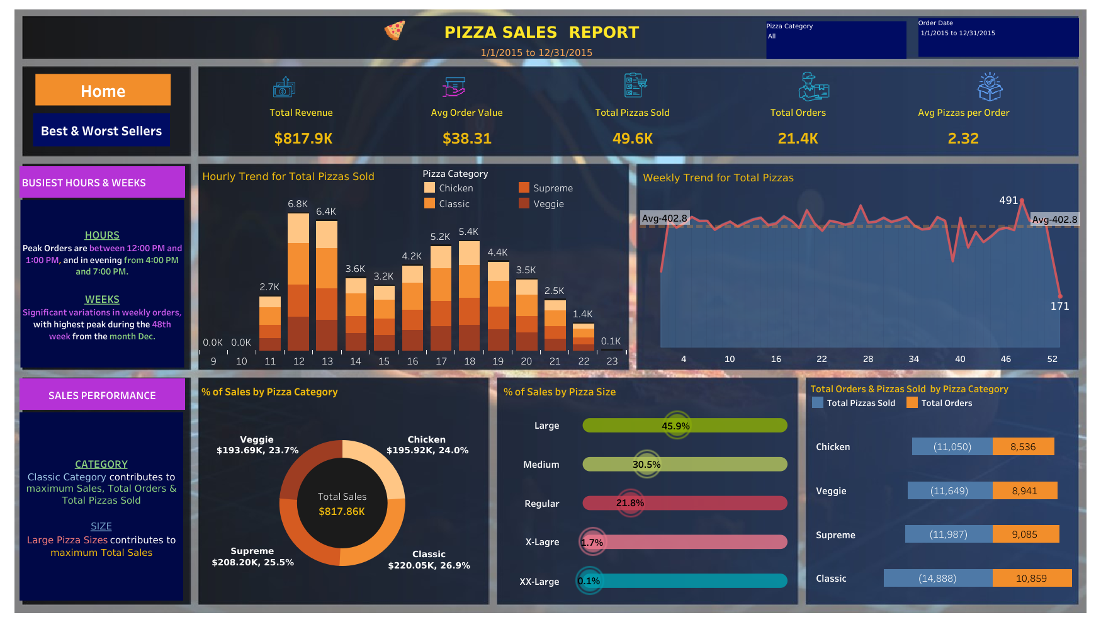

Slide 3
